Slide 1

Generating Web Applications with ViPLab
Virtual Programming Laboratory
Anett
Seeland,
Katharina
Schulze

Slide 2
Overview
Introduction to ViPLab
What can be realized using ViPLab?
Configuration
Example
Tutorial

Slide 3


Introduction to ViPLab
Virtual Programming Laboratory
Browser-based Programming Environment
Goals
No installations (IDEs, …),
Code executed remotely,
Feedback via browser, …
History
Created in 2009
Integrated into eLearning Infrastructure (ILIAS)
Programming Exercises for Students

Slide 4
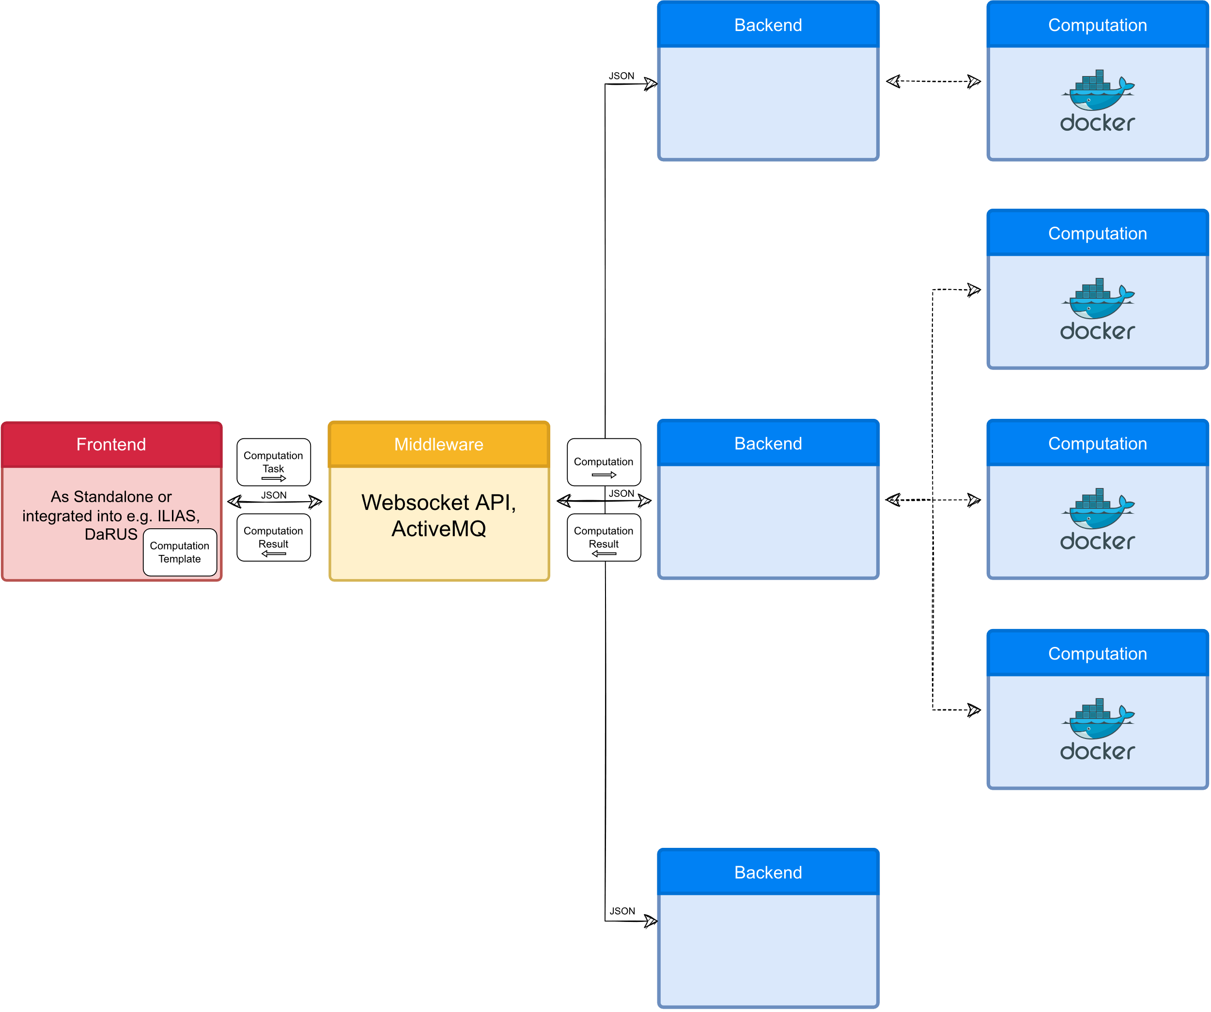
Introduction to ViPLab
Architecture

Slide 5
Introduction to ViPLab
Architecture

Slide 6

Introduction to ViPLab
Architecture

Slide 7
Introduction to ViPLab
Architecture
What does the user see?

Slide 8
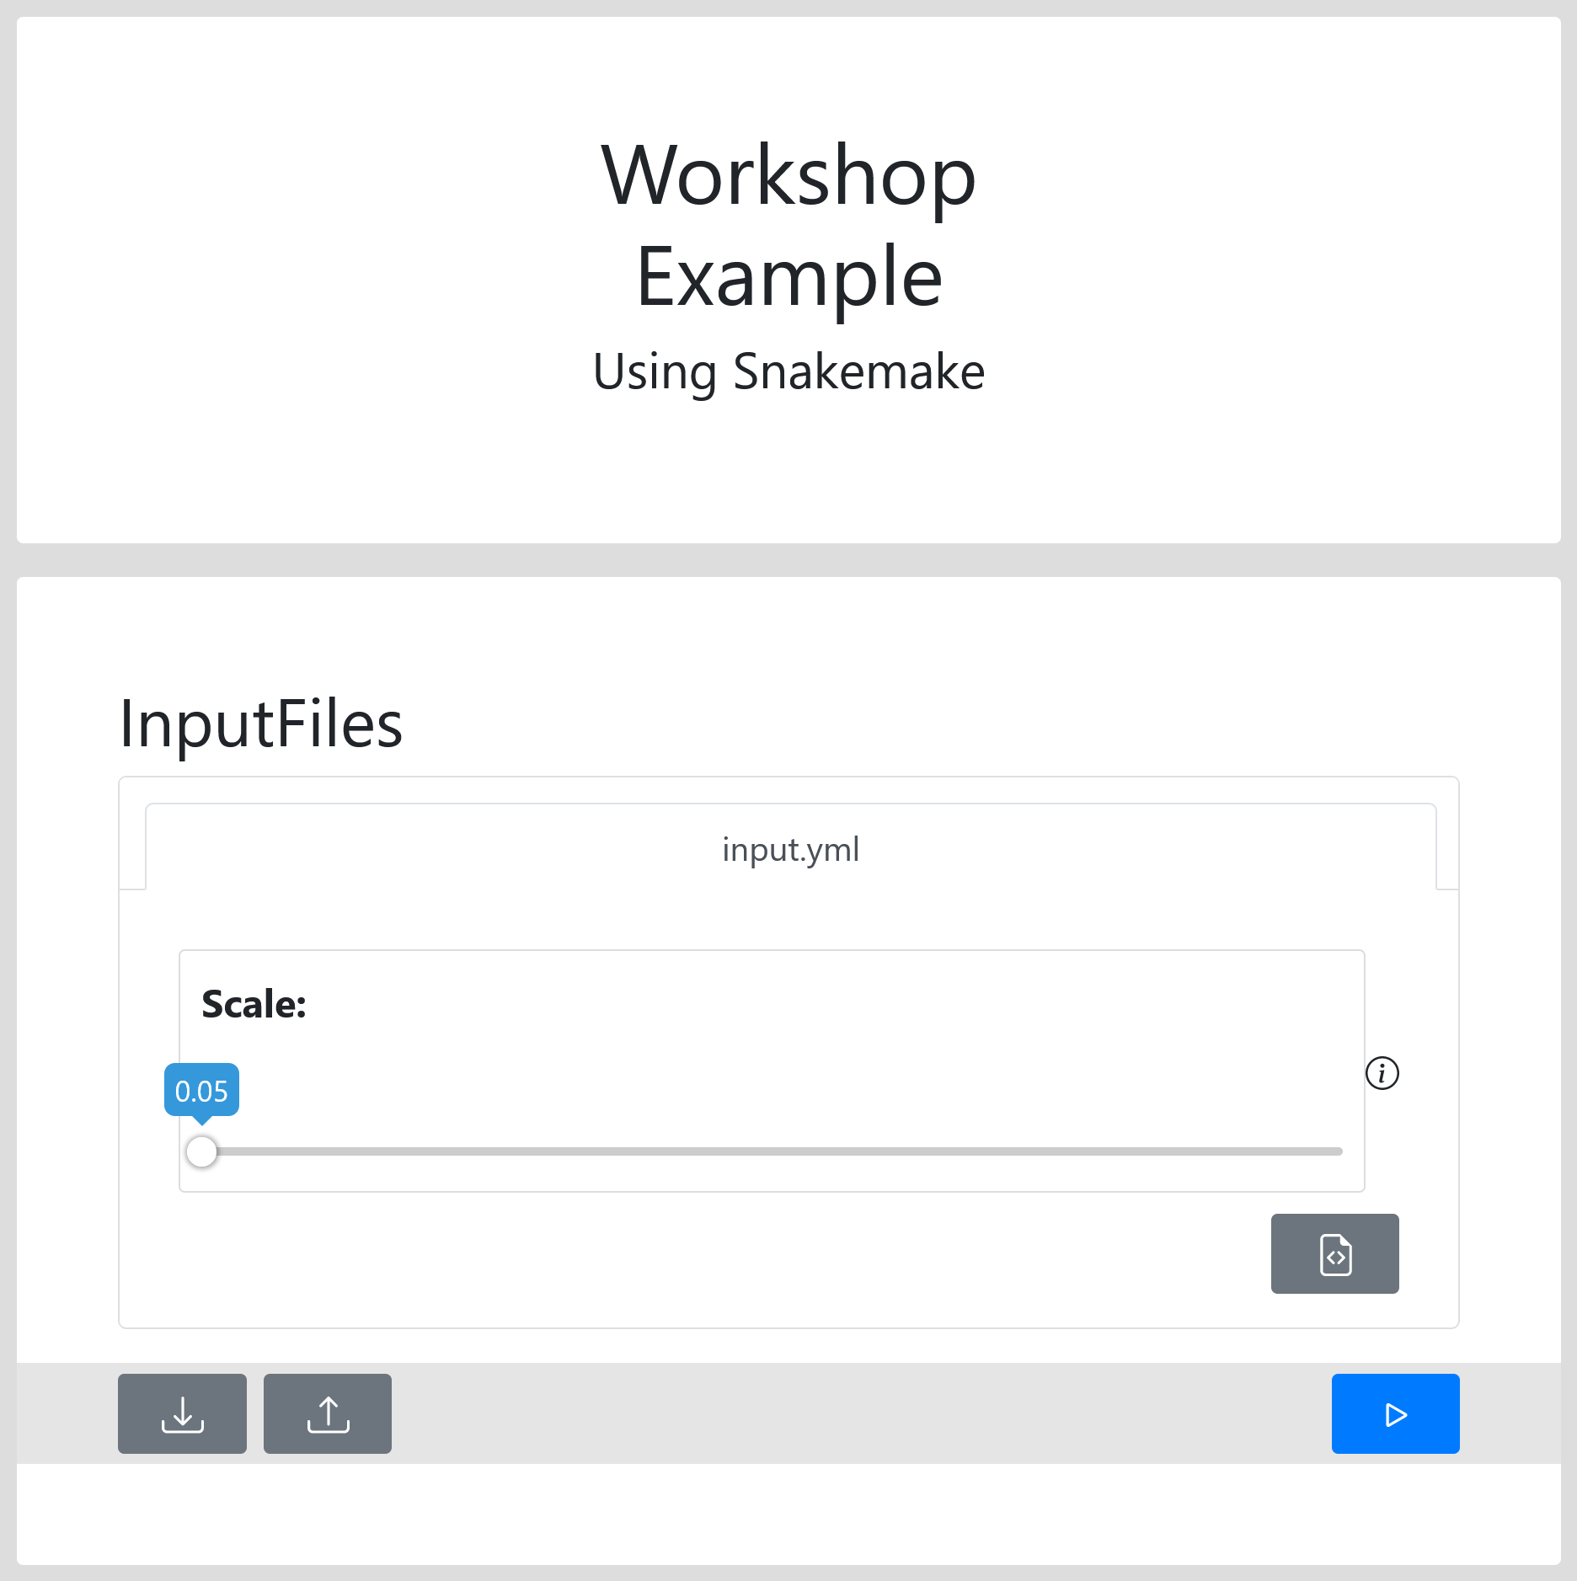
Introduction to ViPLab
Architecture

Slide 9
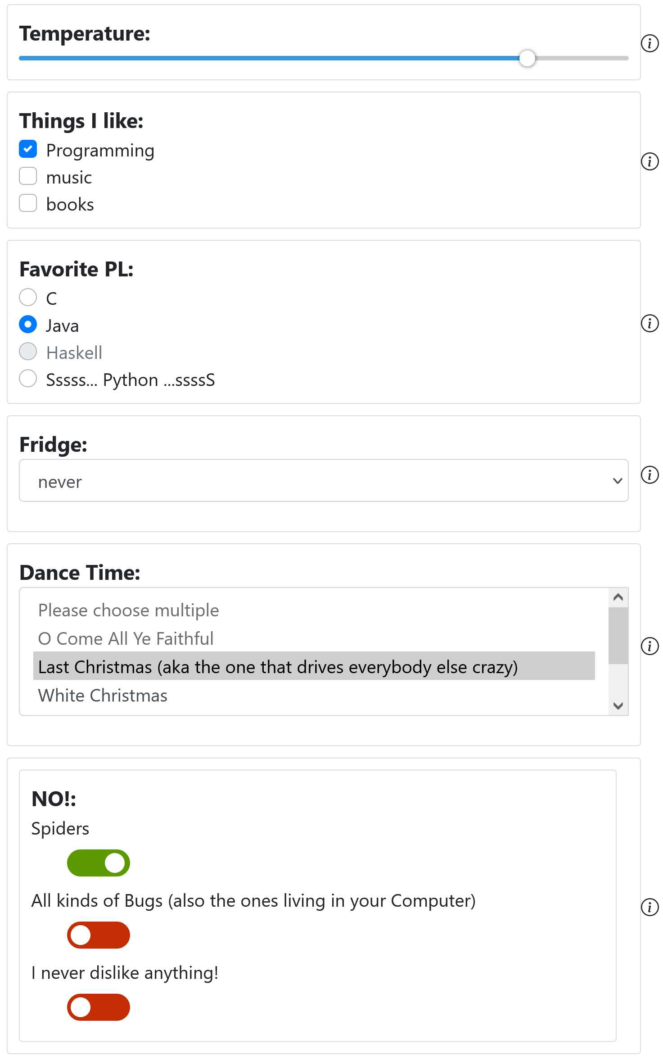
What can be realized using ViPLab?
Features
Execute Docker-Containers
But: Without graphical interaction
Different Access-Levels for the User
Parameterization of Commandline Arguments
Supported Input:
Text-Files
GUI-Elements
Checkbox,
Dropdown,
Slider,
Input-Field, …

Slide 10
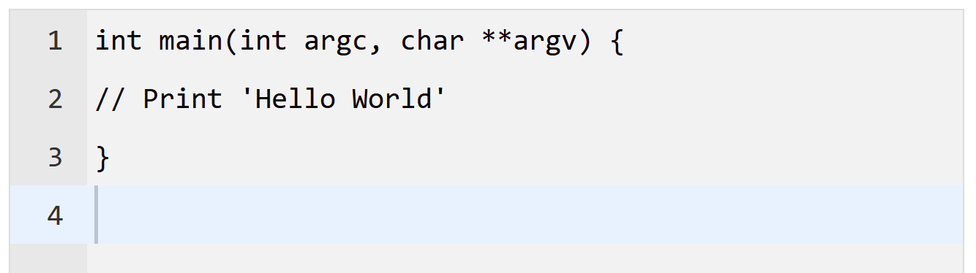
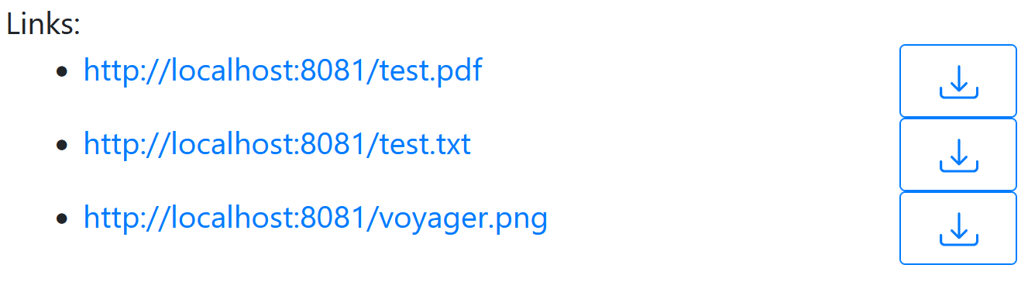

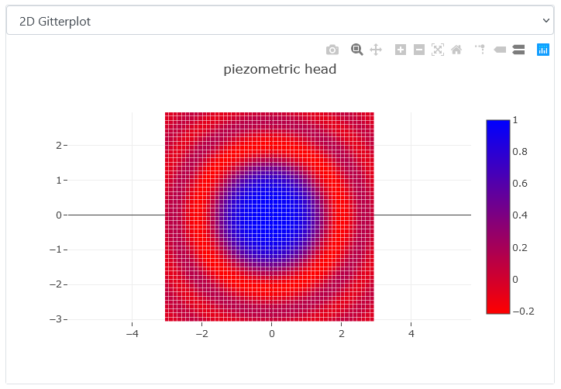
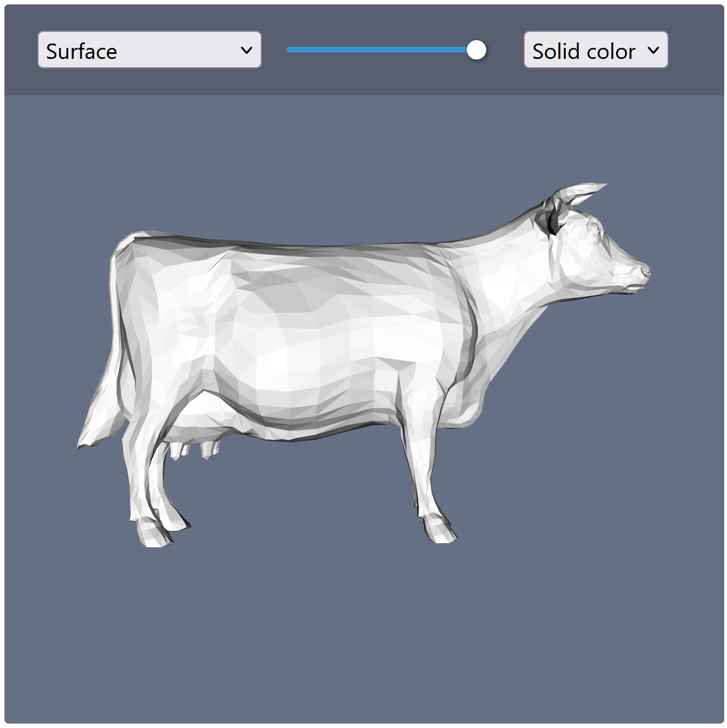
What can be realized using ViPLab?
Features
Supported Outputs:
Stdout, Stderr
Text, JSON
Uri-list
CSV-based Line-Plots
Images
ViPLab-Graphics
VTK, VTP

Slide 11
Configuration
Computation Template
Config-File for ViPLab
Needed to execute software using ViPLab
Defines
How the software is executed
What is and is not shown to the user
Input
Output
Consists of
Files,
Parts,
Access, …

Slide 12
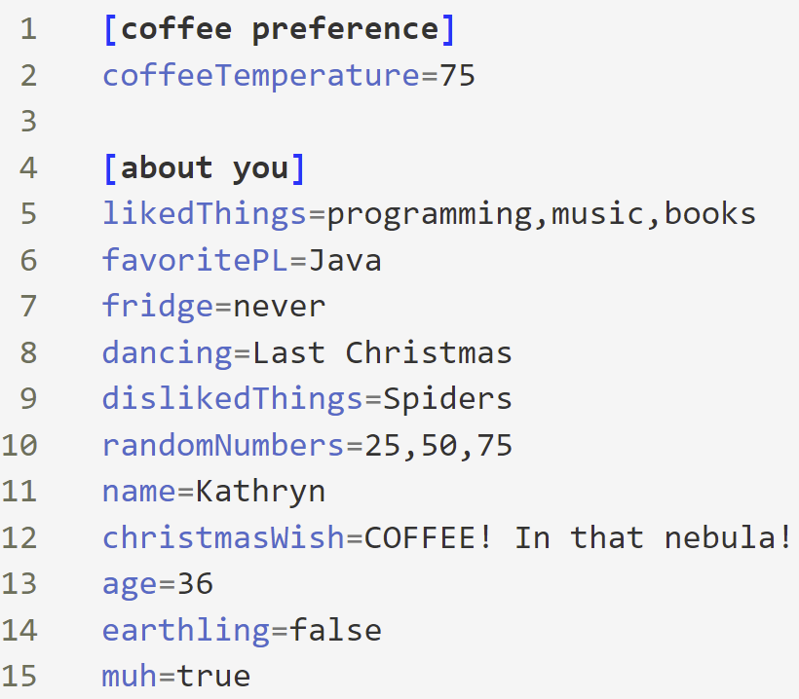
Configuration
Files
E.g.: Code or Input-Files
Can be split into one or more parts
Parts
Define content of file
Handlebars.js
Access
Define what can be seen or modified by the user
Can be set to: visible, modifiable, invisible, template

Slide 13
Configuration
Why should I split Files in several Parts? - Access
Situation: You want the user to have a glimpse at your Code
Do you want to hide a part of the file, because the Code is not relevant for the user?
Invisible
But at the same time, show the user part of your Code?
Visible
The user should be able to modify your Code?
Modifiable
You want the user to be able to modify something (parameters or code), but you want to reduce error-proneness, so you decide to let the user perform modifications using form-elements?
template

Slide 14
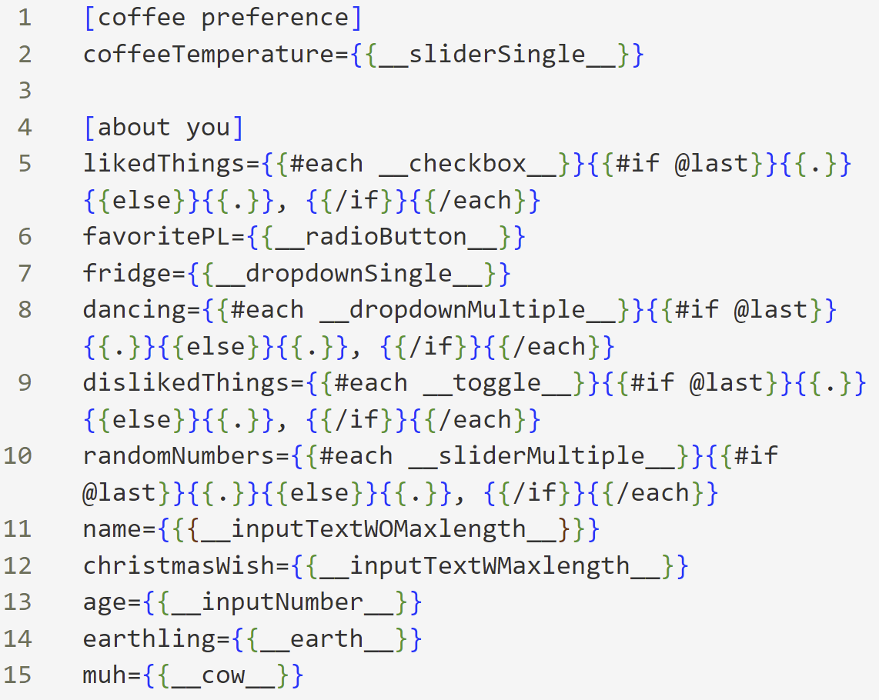
Configuration
Set content of Parts – Access: template

Slide 15
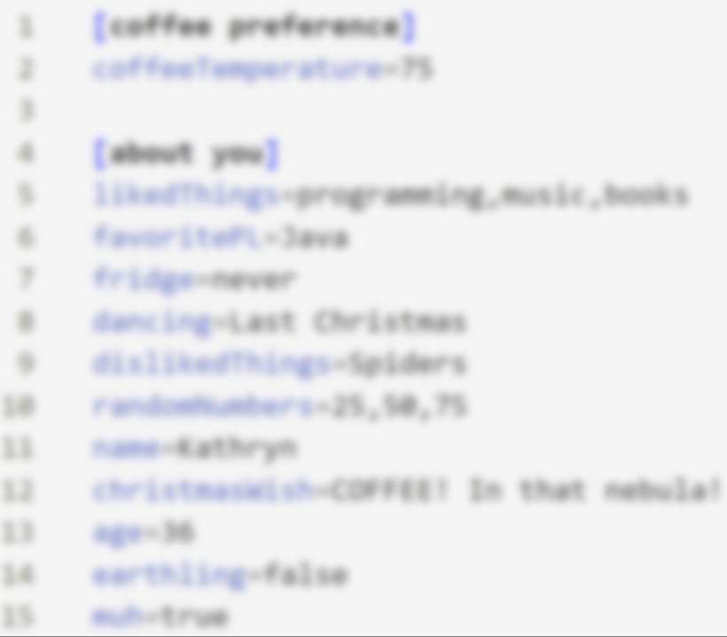
Configuration
Set content of Parts – Access: template

Slide 16
Configuration
Message Contents
Computation Task
Filled in Computation Template
Computation
Input for Backend
Combination of Computation Template and corresponding Computation Task
Computation Result
Result of Computation
Contains
Stdout, Stderr
Artifacts (e.g. Images, CSVs, VTKs, …)

Slide 17
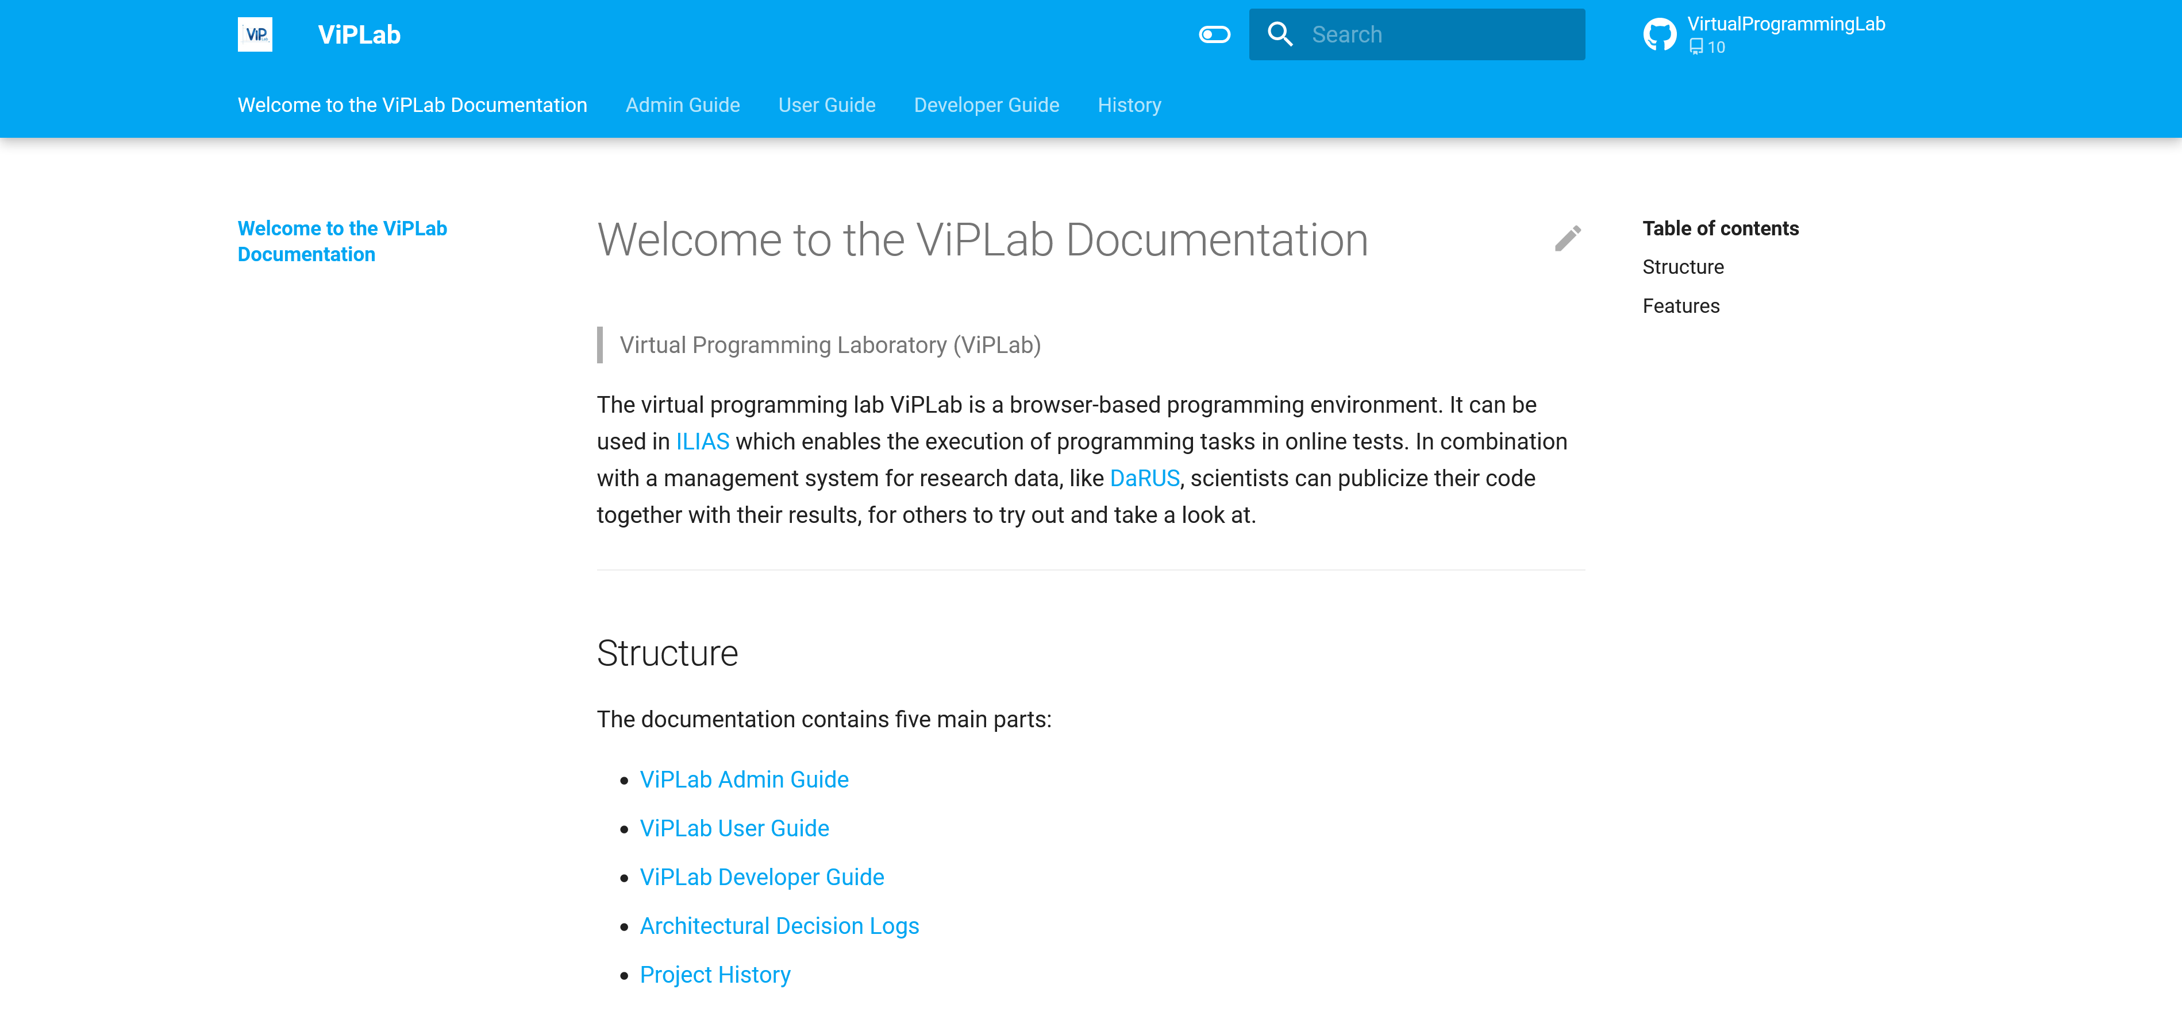
Configuration
Documentation

Slide 18

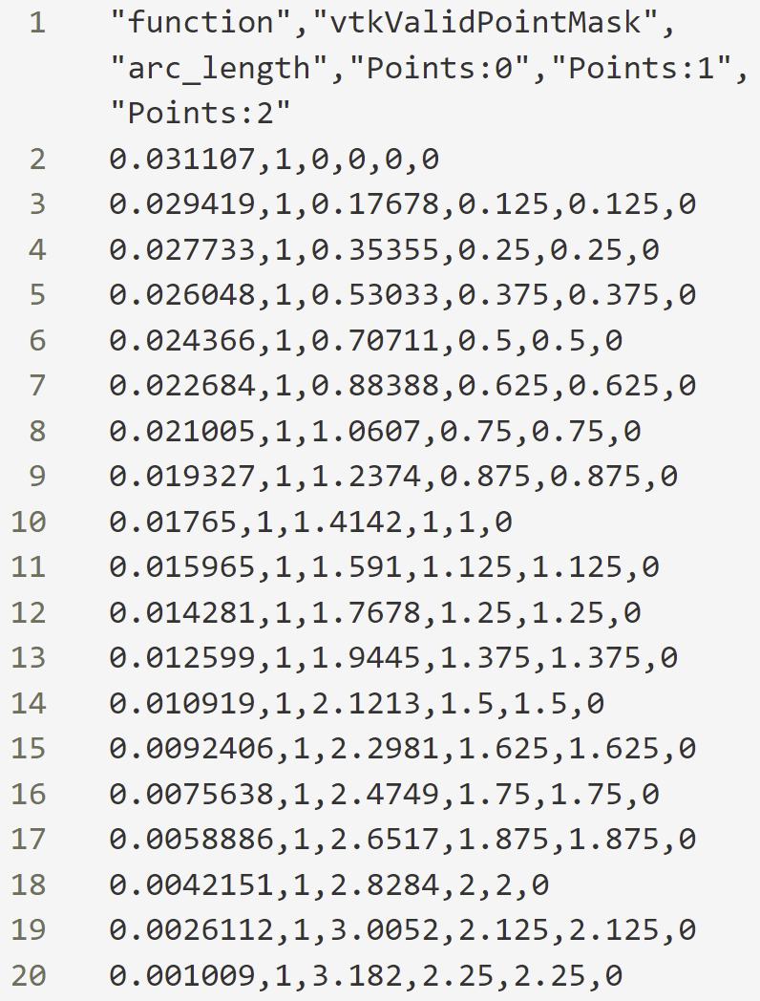
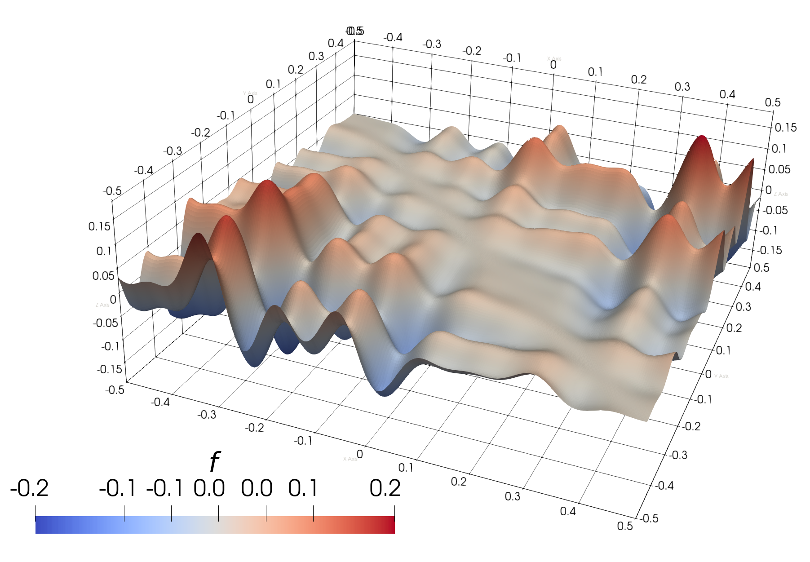
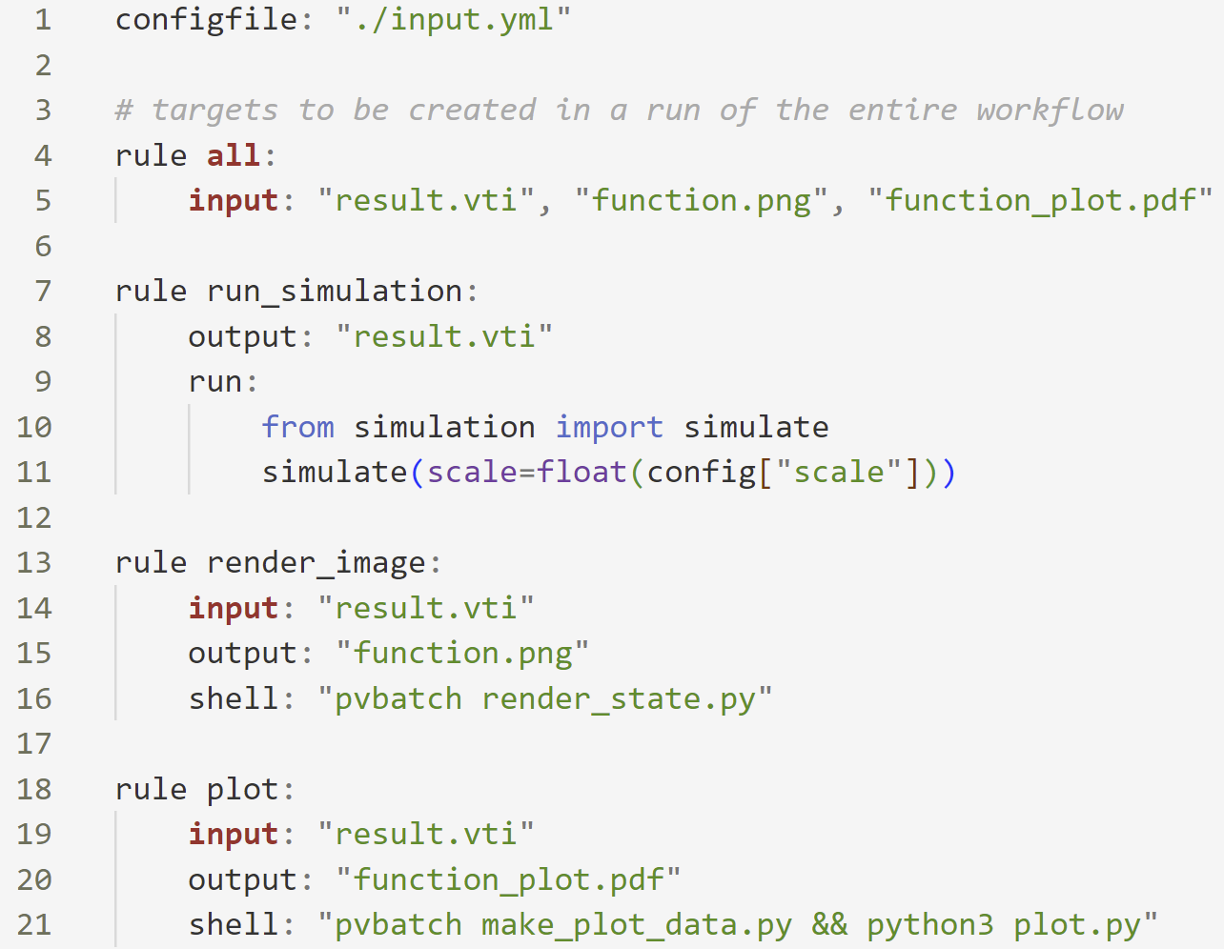
Example
Example-Application
Input
Output

Slide 19
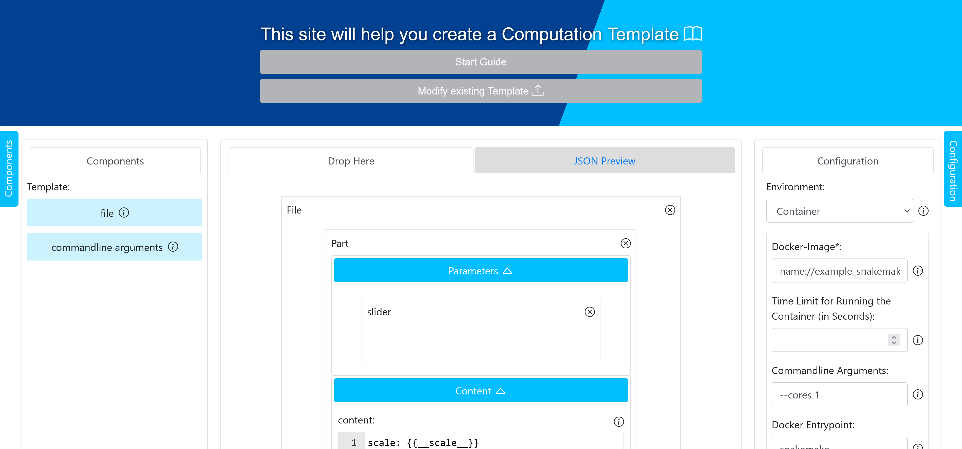
Example
Create a Computation Template

Slide 20
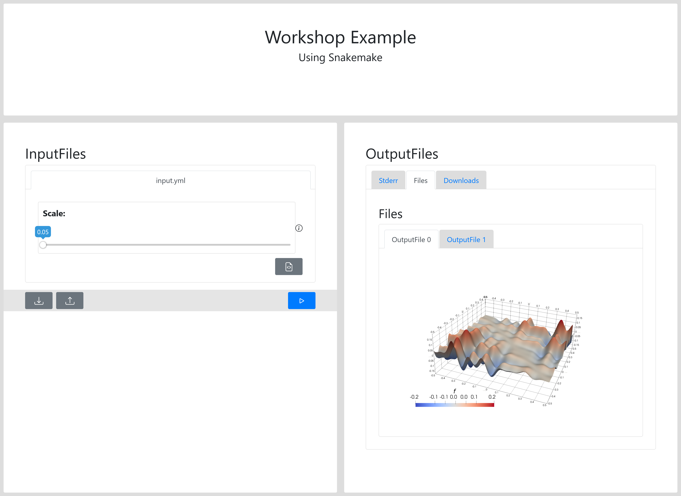
Example
Execution using ViPLab

Slide 21
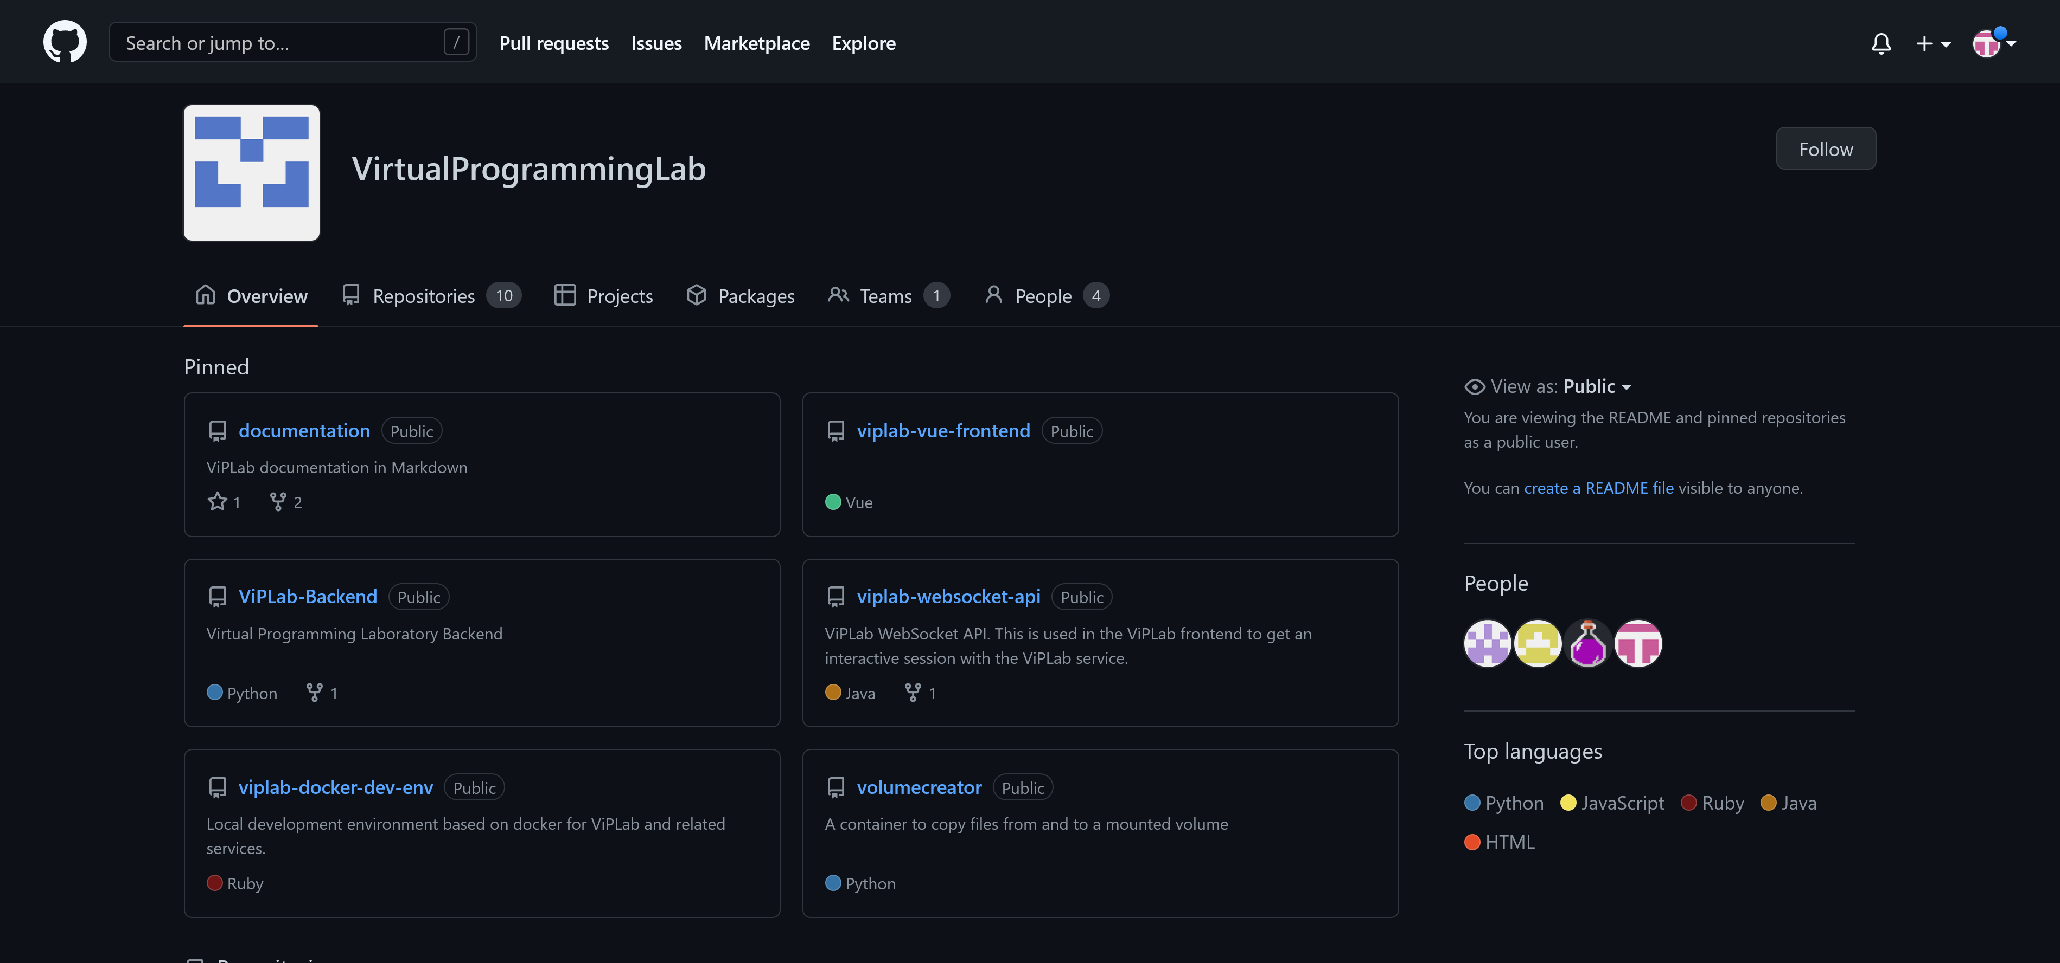
Tutorial
How to set up ViPLab?

Slide 22
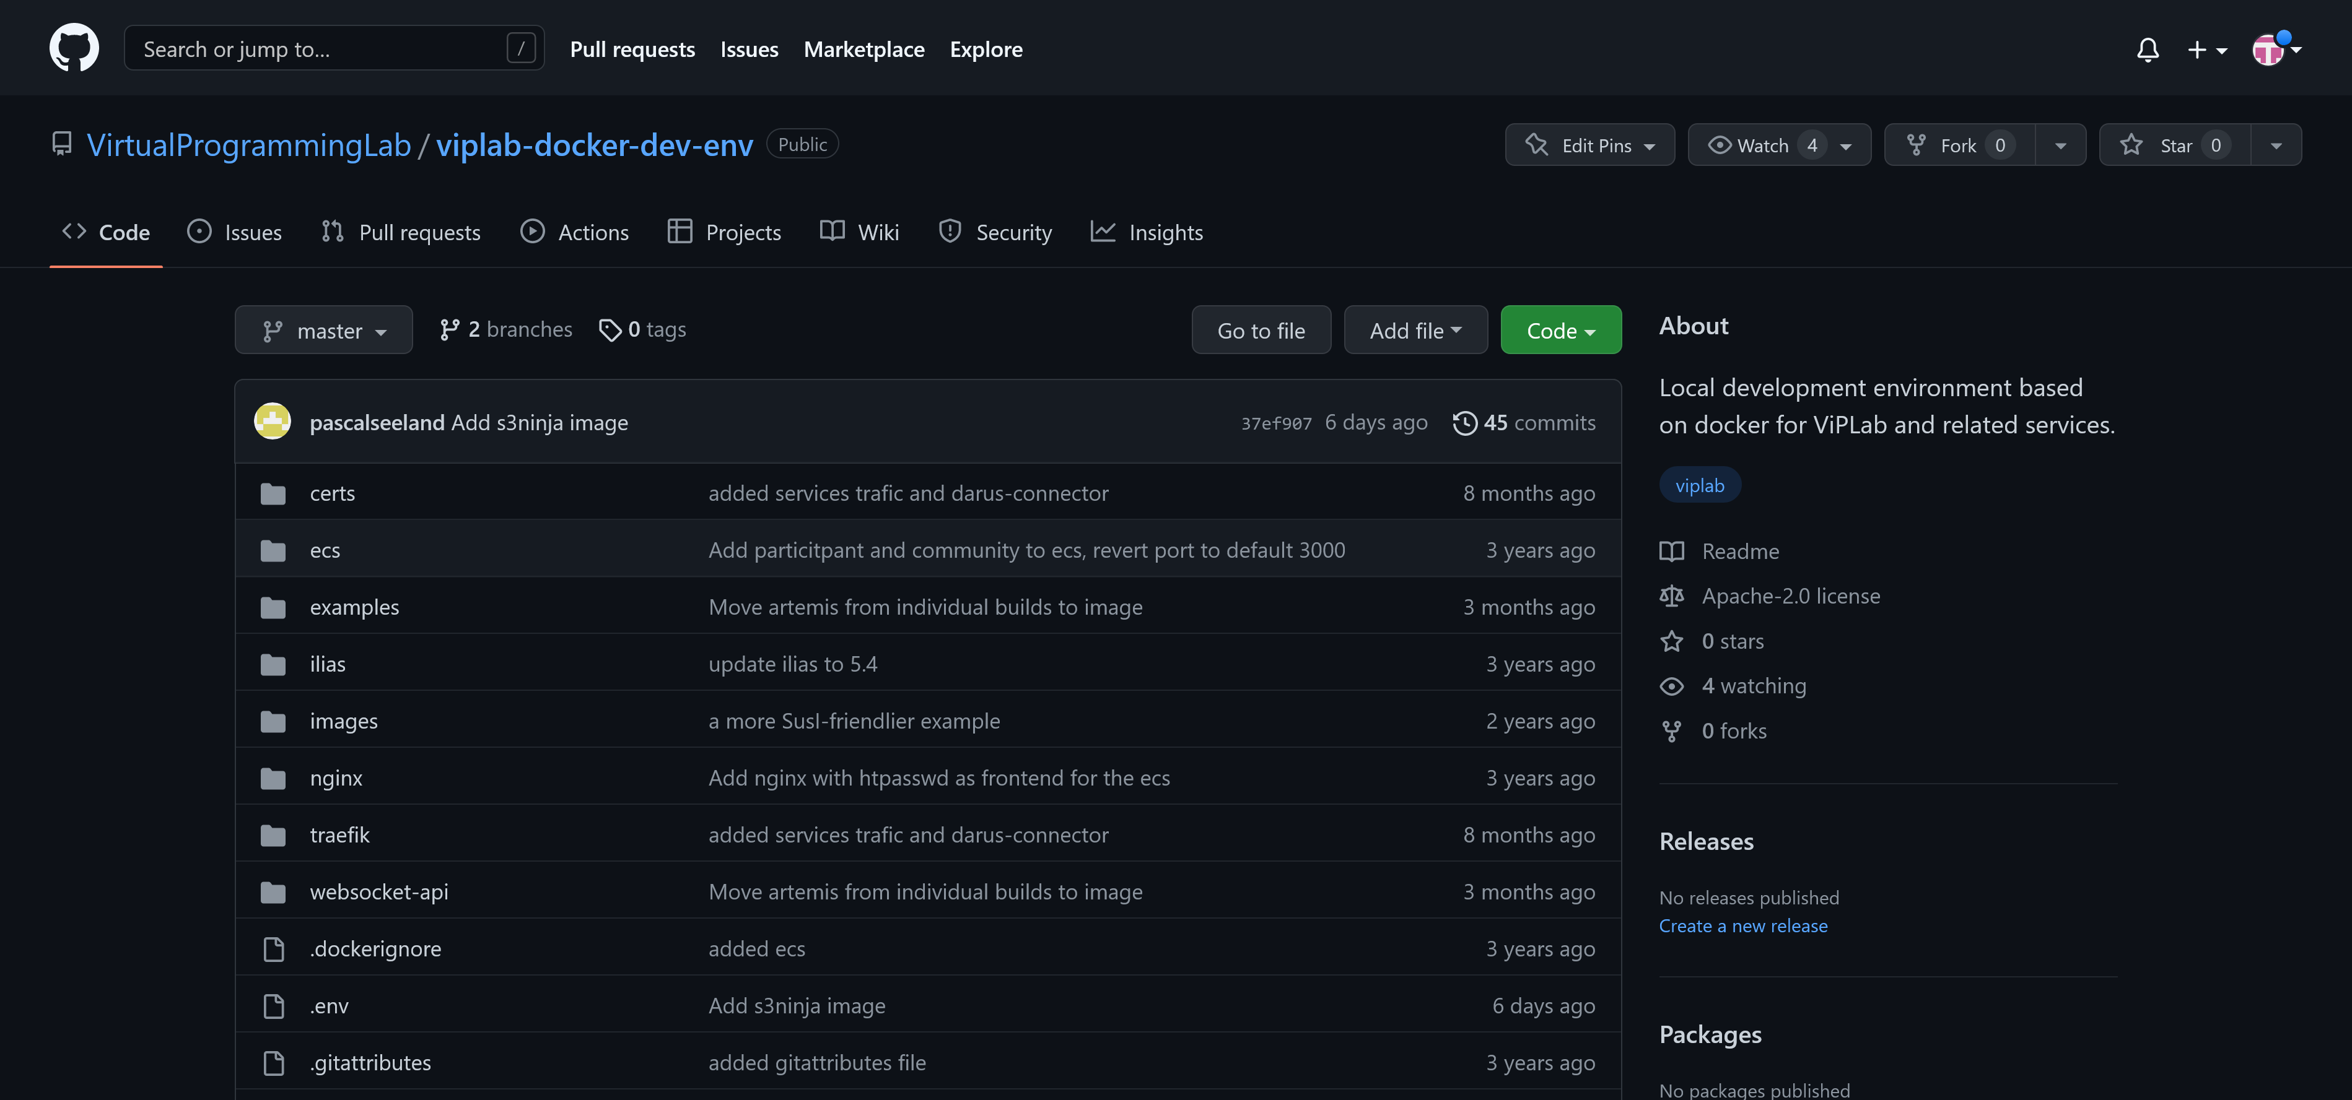
Tutorial
How to set up ViPLab?

Slide 23
Tutorial
How to set up ViPLab?
Prerequisites
Docker and Docker Compose
Step 1: Generate JSON Web Keys
docker run --rm ghcr.io/legion2/json-web-key-generator jwk-generator -t RSA -s 2048 -S -p -i mykeyid
Copy Result to jwks.json and jwks.private.json
Step 2: Rebuild Docker Images
docker-compose --profile standalone --profile s3 build
Step 3: Run Application
docker-compose --profile standalone --profile s3 up

Slide 24
Important Links
ViPLab-GitHub-Organization
https://github.com/VirtualProgrammingLab
ViPLab-Docker-Development-Environment
https://github.com/VirtualProgrammingLab/viplab-docker-dev-env
Documentation: Computation Template
https://virtualprogramminglab.github.io/documentation/developer/computation_template/
Most Common Validation Errors
https://virtualprogramminglab.github.io/documentation/user/validation/

Slide 25
Errors & Solutions
On the go…

